Slide 1
The Other Side of Value: The Gross Profitability Premium
Robert Novy-Marx
Presented by Menglan (Demi) Xu

Slide 2
Useful Concepts
Book-to-market:
Book-to-market = Book Value of Firm / Market Value of Firm
Gross Profitability:
Profitability = Gross Profit (Revenues - Cost of Goods Sold) / Assets
Value Strategy Vs. Growth Strategy
Fama-French 3 Factors

Slide 3
Brief Theoretical Framework

Slide 4
Gross Profitability
Fama & French’s view: book-to-market and profitability are both positively related to expected returns using the dividend discount model in conjunction with clean surplus accounting
Lower valuations (i.e., value firms) => higher expected returns
Higher expected earnings (i.e., profitable firms) => higher expected returns
Time-t earnings
Change in book equity

Slide 5
Gross Profitability
Gross profit is the cleanest accounting measure of true economic profitability
Example:
A firm that has both lower production costs and higher sales than its competitors => more profitable.
However, it can easily have lower earnings than its competitors

Slide 6
Gross Profitability
Construct the empirical proxy for productivity using gross profits.
Scale gross profits by book assets, not book equity, because gross profits are an asset level measure of earnings. They are not reduced by interest payments and are independent of leverage

Slide 7
Insights on The Relationship Between Profitability and Value

Slide 8
Data
Compustat quarterly data on NYSE stocks covering from July 1963 to December 2010.
The sample excludes financial firms (those with one-digit SIC codes of six)
because the high leverage that is normal for these firms probably does not have the same meaning as for non-financial firms, where high leverage more likely indicates distress

Slide 9
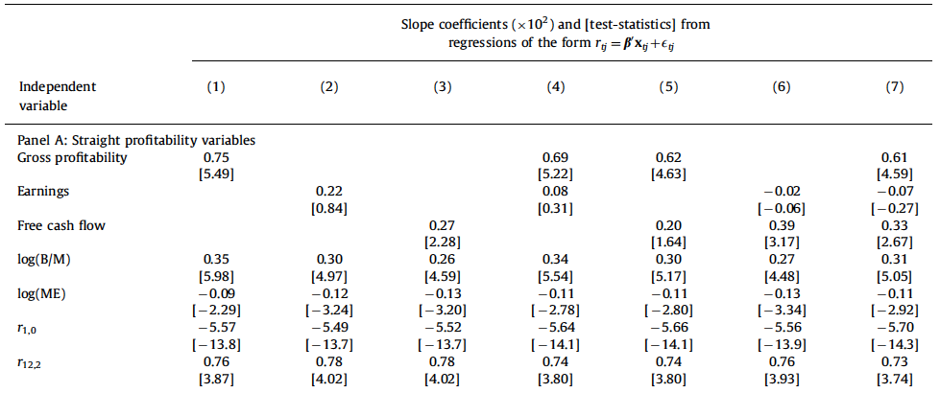
Fama-MacBeth Regressions
Gross profitability includes earnings and FCF and it has the greatest power in explaining returns

Slide 10
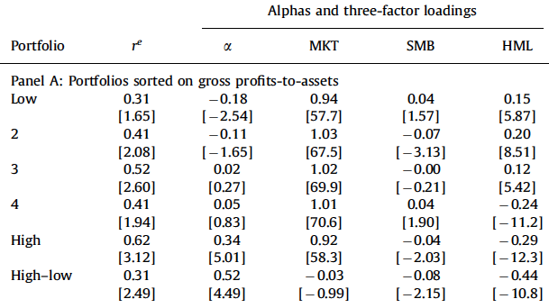
Univariate Sort on Gross Profits-to-asset
Gross profits-to-assets portfolios’ average excess returns are generally increasing with profitability
Significant negative loadings on HML (value premium), and significant excess return of high-low
Conclusion:
The strategy is a growth strategy, thus a “perfect” hedge for value strategy
The performance of value strategies can be improved by controlling for profitability and the performance of profitability strategies can be improved by controlling for book-to-market.
Profitability strategy

Slide 11
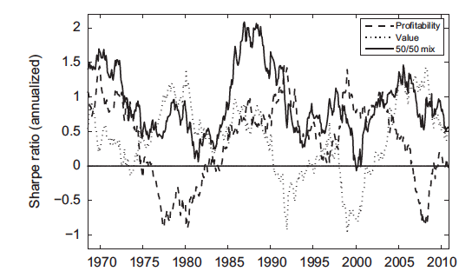
A “Perfect” Hedge

Slide 12
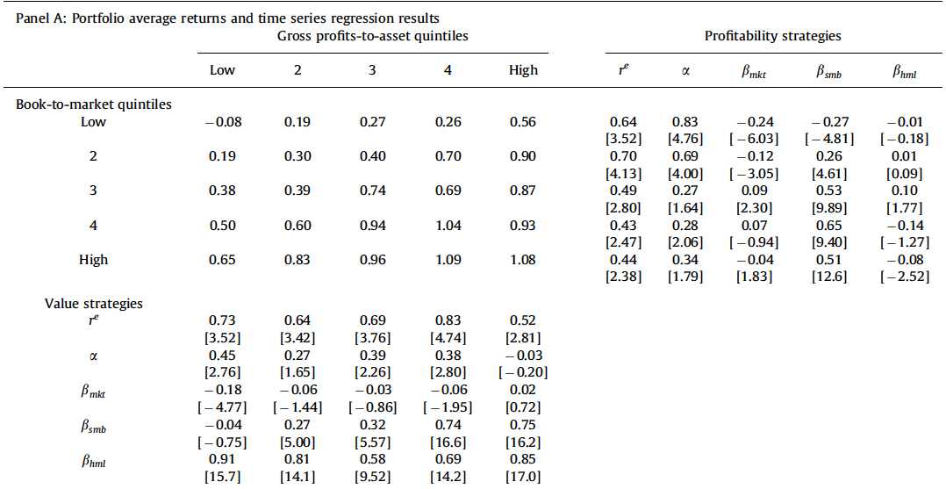
Double Sorts on Profitability and Book-to-market
The table confirms the prediction that controlling for profitability improves the performance of value strategies and controlling for book-to-market improves the performance of profitability strategies.

Slide 13
Profitability Commonalities Across Anomalies

Slide 14
Set of Alternative Factors and Three Types of Anomalies Considered
A set of alternative factors:
Industry-adjusted book-to-market (HML*)
Past performance (Momentum, up minus down or UMD*)
Gross profitability (Profitable minus unprofitable or PMU*)
Three types of anomalies considered:
Anomalies related to the construction of the factors themselves
Earnings-related anomalies
Anomalies considered by the author in another paper

Slide 15
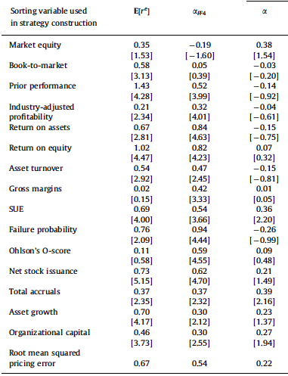
Anomaly Strategy Average Excess Returns and Performance vs. FF4
The second column shows the strategies’ average monthly excess returns
The third column shows the strategies’ abnormal returns relative to FF4 model (constructed based on FF3 and profitability factor)
The fourth column shows that the alternative four- factor model almost explains the returns to all of the strategies
Notes:
All the strategies, with the exception of the size strategy, exhibit highly significant average excess returns over the sample.
The third column shows that the standard Fama and French four-factor model performs extremely poorly pricing earnings-related anomalies.

Slide 16
Conclusion

Slide 17
My Opinion
Statistically significant of adding a profitability factor
Anomalies testing proves the author’s point on adding a profitability factor
Results significant in the US market
Yet there is no convincing economic story behind
The anomalies chosen are somehow arbitrary and not general
May not work in other market, for example, Hong Kong market

Slide 18
Additional
Fama and French 5 factors model (2014)
Constructed based on ideas similar to Novy-Marx’s
RMW: profitability factor, CMA: investment factor
Results suggest HML is a redundant factor in the sense that “its high average return is fully captured by other 4 factors” (i.e., MKT, SMB and especially RMW and CMA)

Slide 19
Thank you!

